Slide 1
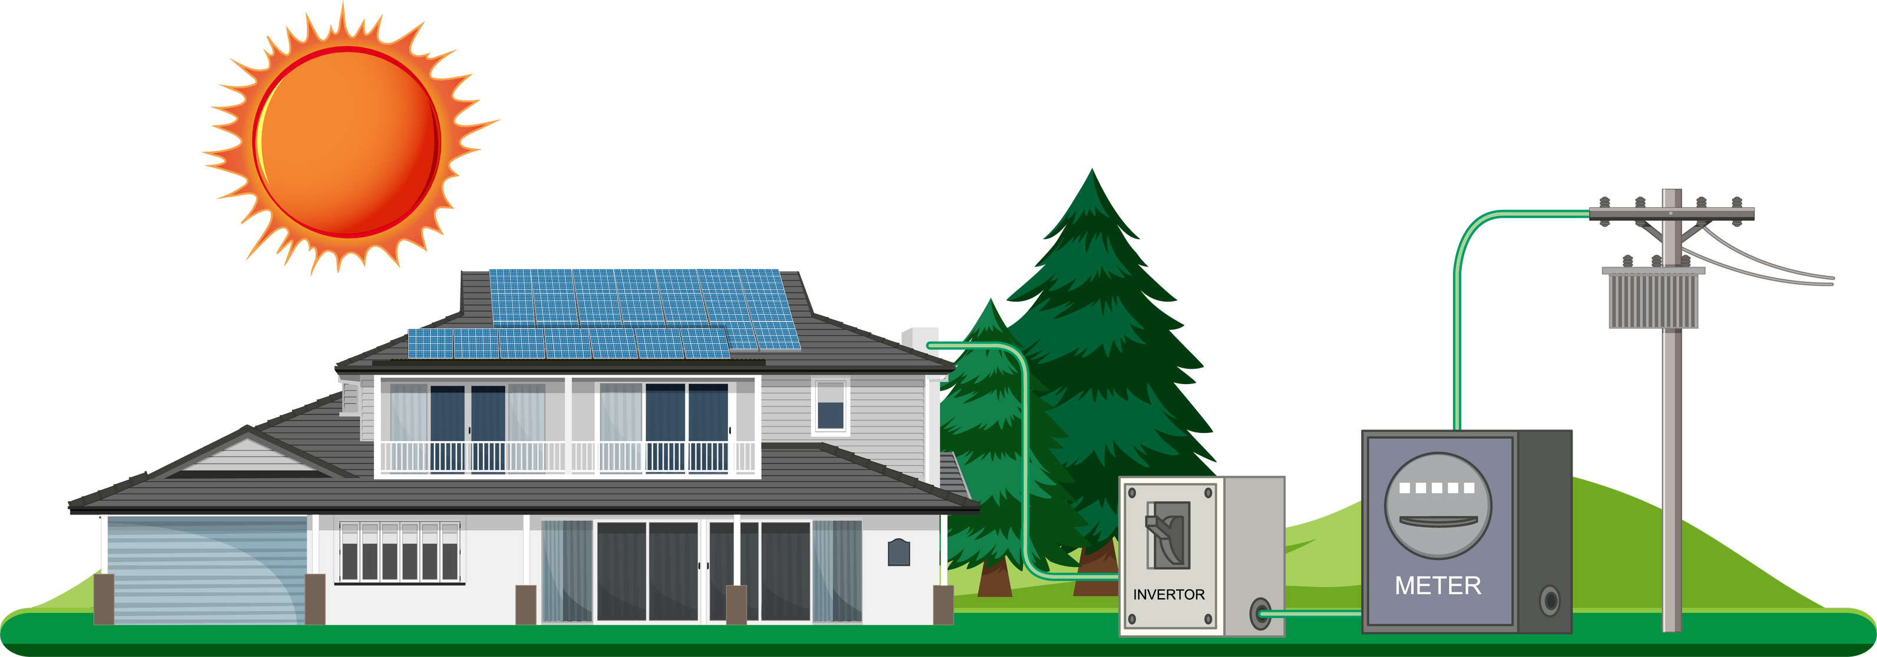
Grade 5
Types of Energy
A Journey Through the Different Forms

Slide 2

OBJECTIVE
Today, we will explore the different kinds of energy that are present and help to shape our world. We’ll explore:
Kinetic Energy | Potential Energy | Thermal Energy | Electrical Energy | Renewable Energy
Chemical Energy | Light Energy | Sound Energy | Nuclear Energy | Non-renewable Energy

Slide 3
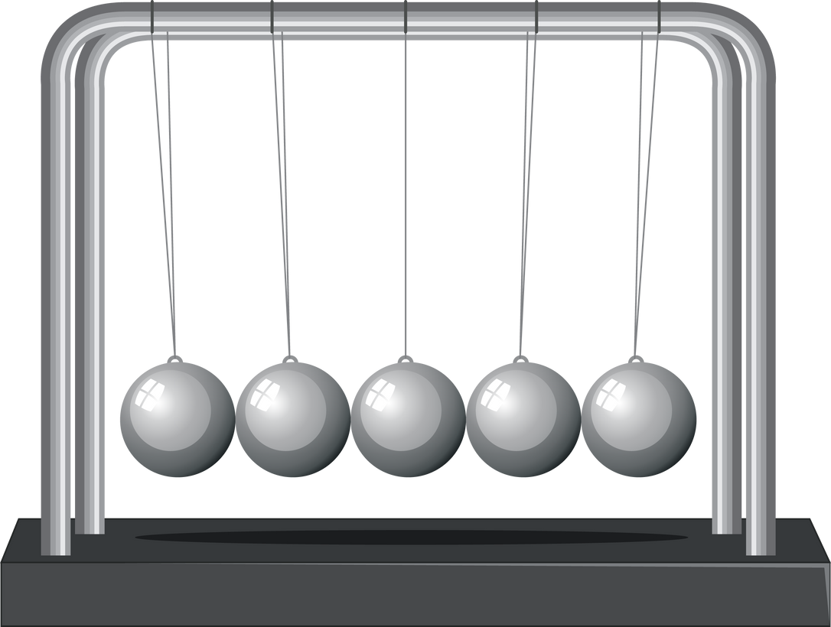
KINETIC ENERGY
  Kinetic energy is the energy of motion.
  Example: A rolling ball, a moving car, or a swinging pendulum.

Slide 4

POTENTIAL ENERGY
  Potential energy is stored energy waiting to be released.
  Example: A stretched rubber band, a raised object like a book on a shelf, or a compressed spring.

Slide 5

THERMAL ENERGY
  Thermal energy is the energy associated with heat.
  Example: Warmth from the sun, a hot cup of tea, or a bonfire.

Slide 6
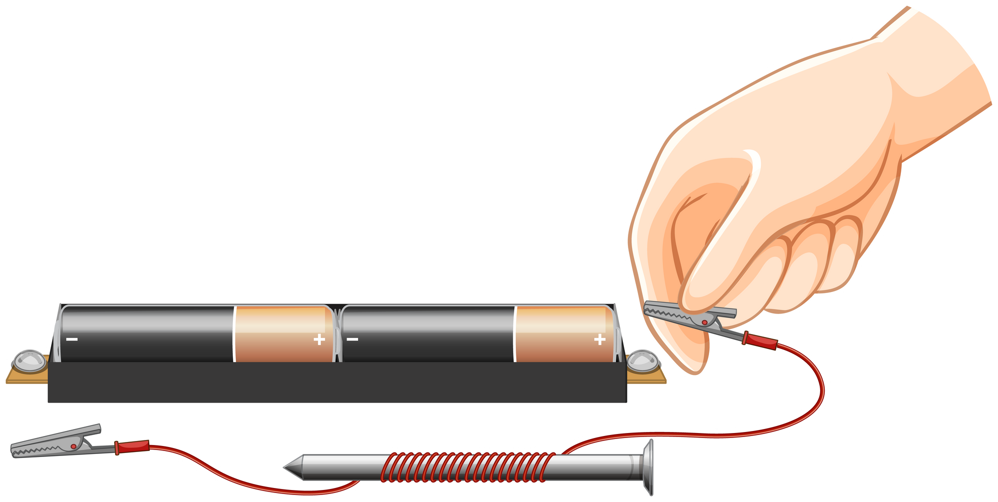
ELECTRICAL ENERGY
  Electrical energy is the flow of electric charge.
  Example: Lightning, batteries powering our gadgets, or electricity flowing through wires.

Slide 7

CHEMICAL ENERGY
  Chemical energy is stored in the bonds of atoms and molecules.
  Example: Food we eat, batteries, or fuels like gasoline.

Slide 8

LIGHT ENERGY
  Light energy is electromagnetic radiation that we can see.
  Example: Sunlight, light bulbs, or the glow of a firefly.

Slide 9

SOUND ENERGY
  Sound energy is produced by vibrations that travel through matter.
  Example: Music, voices, or the chirping of birds.

Slide 10
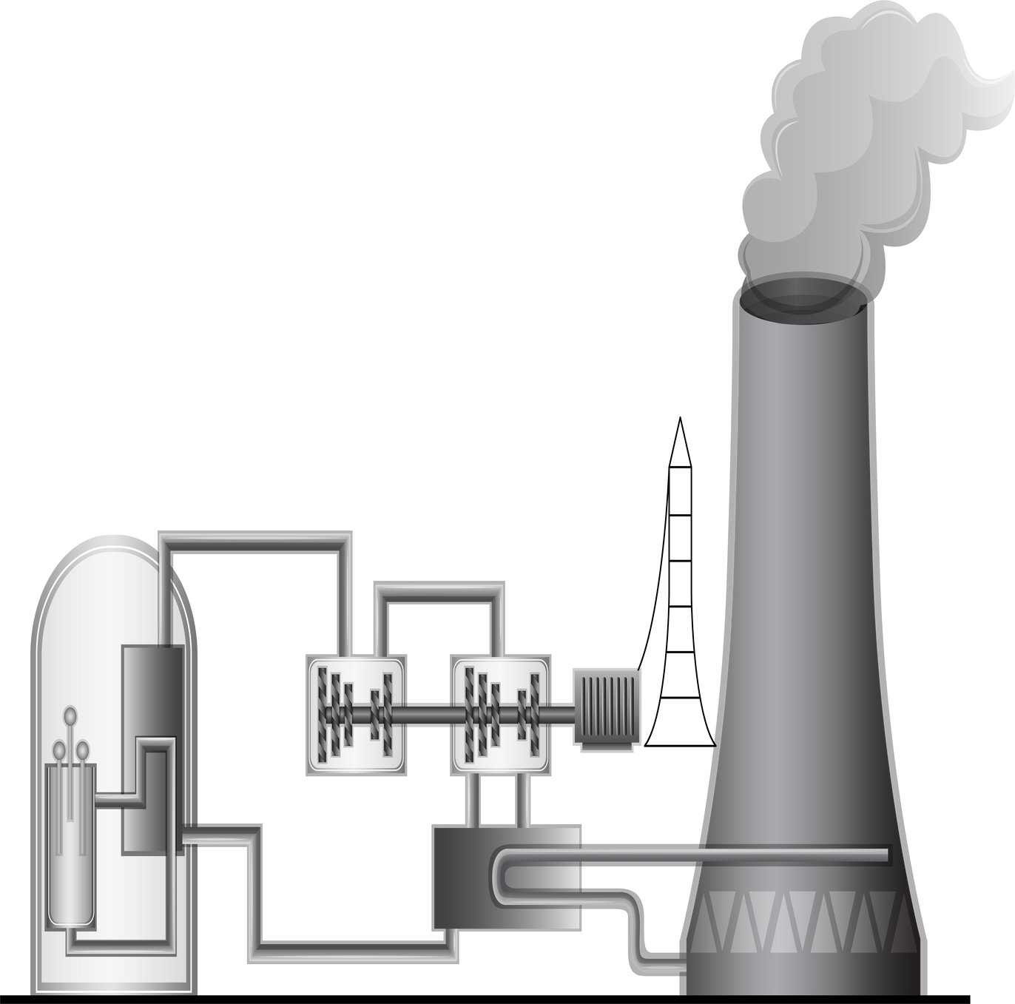
NUCLEAR ENERGY
  Nuclear energy is released during nuclear reactions.
  Example: Energy from the sun (nuclear fusion), or energy produced in nuclear power plants (nuclear fission).

Slide 11

RENEWABLE ENERGY
  Renewable energy comes from sources that are naturally replenished.
  Example: Solar power, wind energy, or hydropower.

Slide 12

NON-RENEWABLE ENERGY
  Non-renewable energy comes from sources that are finite and cannot be easily replenished.
  Example: Fossil fuels like coal, oil, and natural gas.

Slide 13
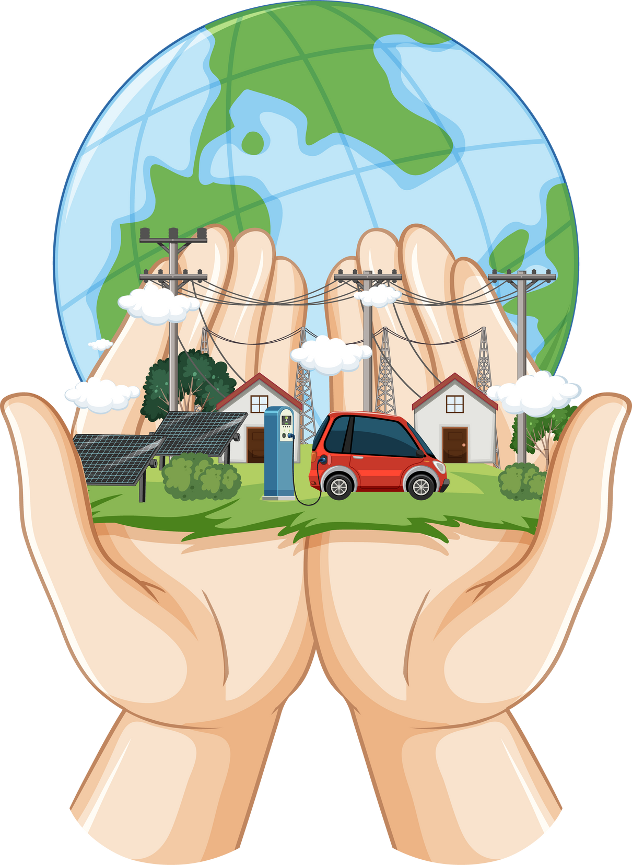
SUMMARY
  Energy surrounds us in its countless forms, shaping the world we live in.
  By understanding and respecting different energy forms, we can make informed choices to create a sustainable future.

Slide 14




GAME TIME!
Match the form of energy with the photo!
Kinetic
Potential
Light
Sound
Thermal

Slide 15
GAME TIME! (ANSWERS)
Match the form of energy with the photo!
Kinetic
Potential
Light
Sound
Thermal
Kinetic
Potential
Light
Sound
Thermal

